Slide 1
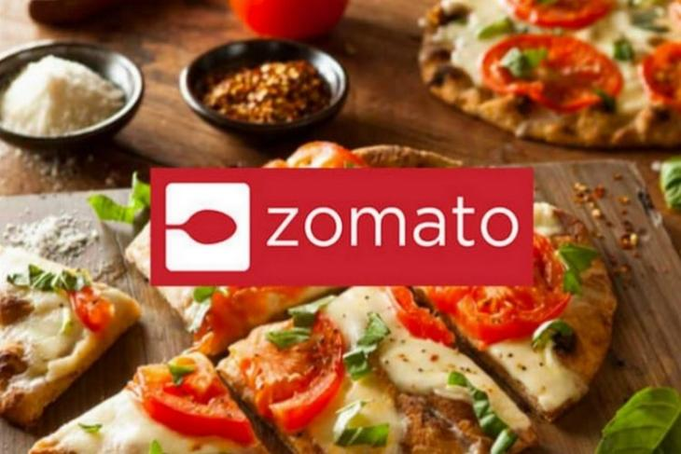

Slide 2

Zomato Sales Analysis
And Rating Dependency Calculation With Machine Learning
Presented by
Soumyadip China(Csug/149/20)
Under the guidance of
: DEBASIS SARDAR
Dept. of Computer Science,
Ramakrishna Mission Residential college,
Narendrapur (Autonomous),Calcutta University. West Bengal, India.

Slide 3
Table Of Contents:
Problem Statement
Introduction
Related Works
Methodology
Result
Observation
Conclusion
Reference
Appendix
Acknowledgement

Slide 4
1.PROBLEM STATEMENT
Whenever we visit a new place ,we want to go to the best restaurant .The best restaurant indicates the cheapest but decent one.
If we want to try food in some new restaurants we first look at the ratings or the reviews .Ratings or reviews are considered to be one of the most or decisive variables that decide how good a restaurant is.We will therefore use the real time data set here in our project that has different factors that a user can look into about a restaurant. We restrict our data only to Bangalore city.

Slide 5
Here we will use Zomato dataset and in this dataset our target variable is the “Rates” Column.
We will explore the relationship of other features in the dataset with respect to Rates. We will visualize the relation of all the other dependent features with respect to our target variable, and hence find the most corelated features which effects our target variable.

Slide 6
We would then implement the data in various modelling structures such as Random Forest, Linear Regression, Decision Tree, Extra Tree Regression.
These modelling will then give us the accuracy of prediction and then we could state which model gives us the most optimized and accurate readings.

Slide 7
2.INTRODUCTION:
Bengaluru is India’s It capital .Most people here are mostly reliant on restaurant food because they don’t have much time to prepare for themselves. It has thus become important to research the demographics of a place with such an enormous demand for restaurants.
The growing number of restaurants and dishes in Bangalore is what attracts me to inspect the data to get some insights ,some interesting facts and figures.

Slide 8
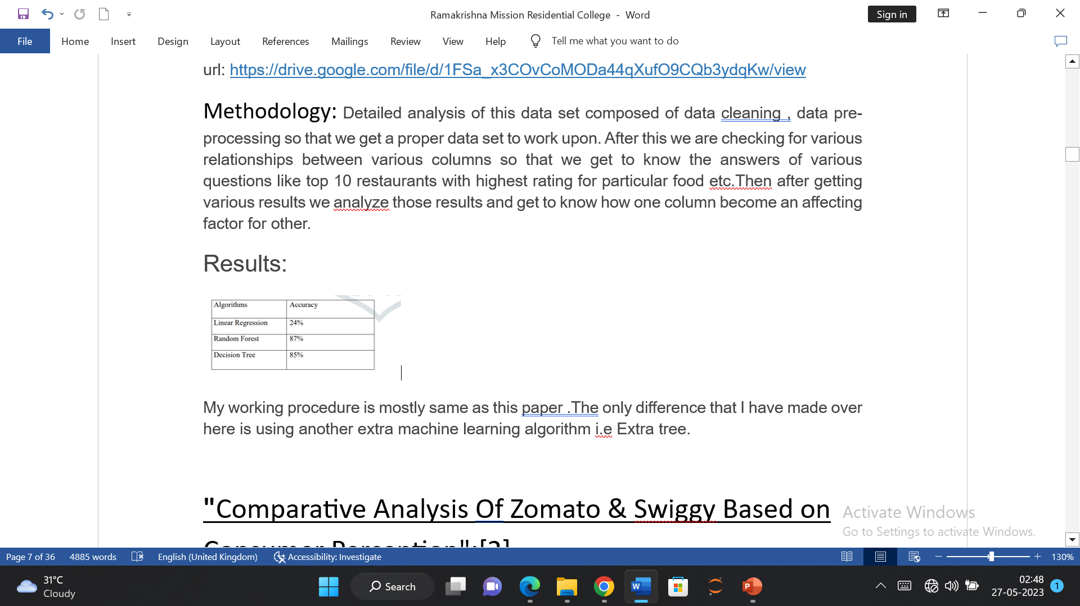
3.Related Works:
Zomato Data Analysis:[1]
Methodology: Detailed analysis of this data set composed of data cleaning , data pre-processing so that we get a proper data set to work upon. After this we are checking for various relationships between various columns so that we get to know the answers of various questions like top 10 restaurants with highest rating for particular food etc.Then after getting various results we analyze those results and get to know how one column become an affecting factor for other.
.
:

Slide 9
"Comparative Analysis Of Zomato & Swiggy Based on Consumer Perception":[2]
Methodology: The objective of the research is to determine the current best online food delivery company among Zomato & Swiggy from the lens of Indian consumers based on the described 8 factors.
Here a questionnaire has been prepared.
These questions will be based on the 8 decision influencing factors that are {Perceived Service Quality, Proper Flow Of Communication By The Delivery Person, Wide Range Of Options, On Time Delivery , Fresh, Well Cooked & Well Packaged Food, Price and Discounts Offered, Real Time Tracking of Delivery, Online Promotions & Advertisements} wherein for each factor the respondent will have to choose which 11 company according to them is better in that particular factor .

Slide 10
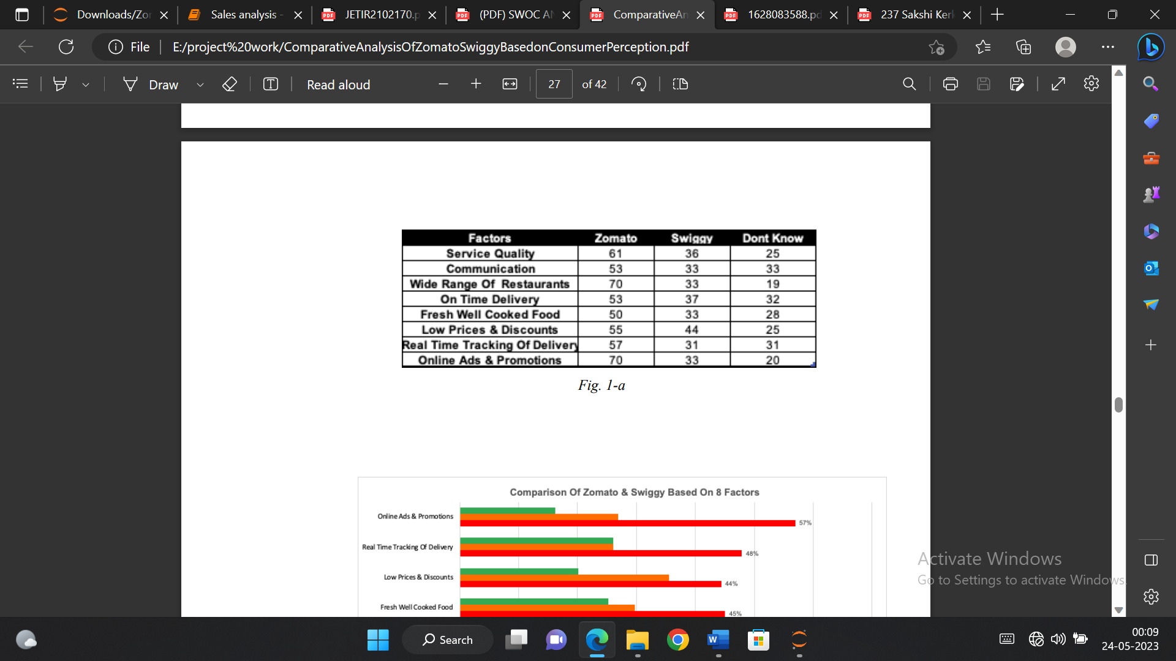
After receiving responses to these questions, a descriptive method of analysis will be adopted and the data will be analysed using Microsoft Excel which will help in making visual representations of the raw data collected and thus provide easier interpretation.
Result:

Slide 11
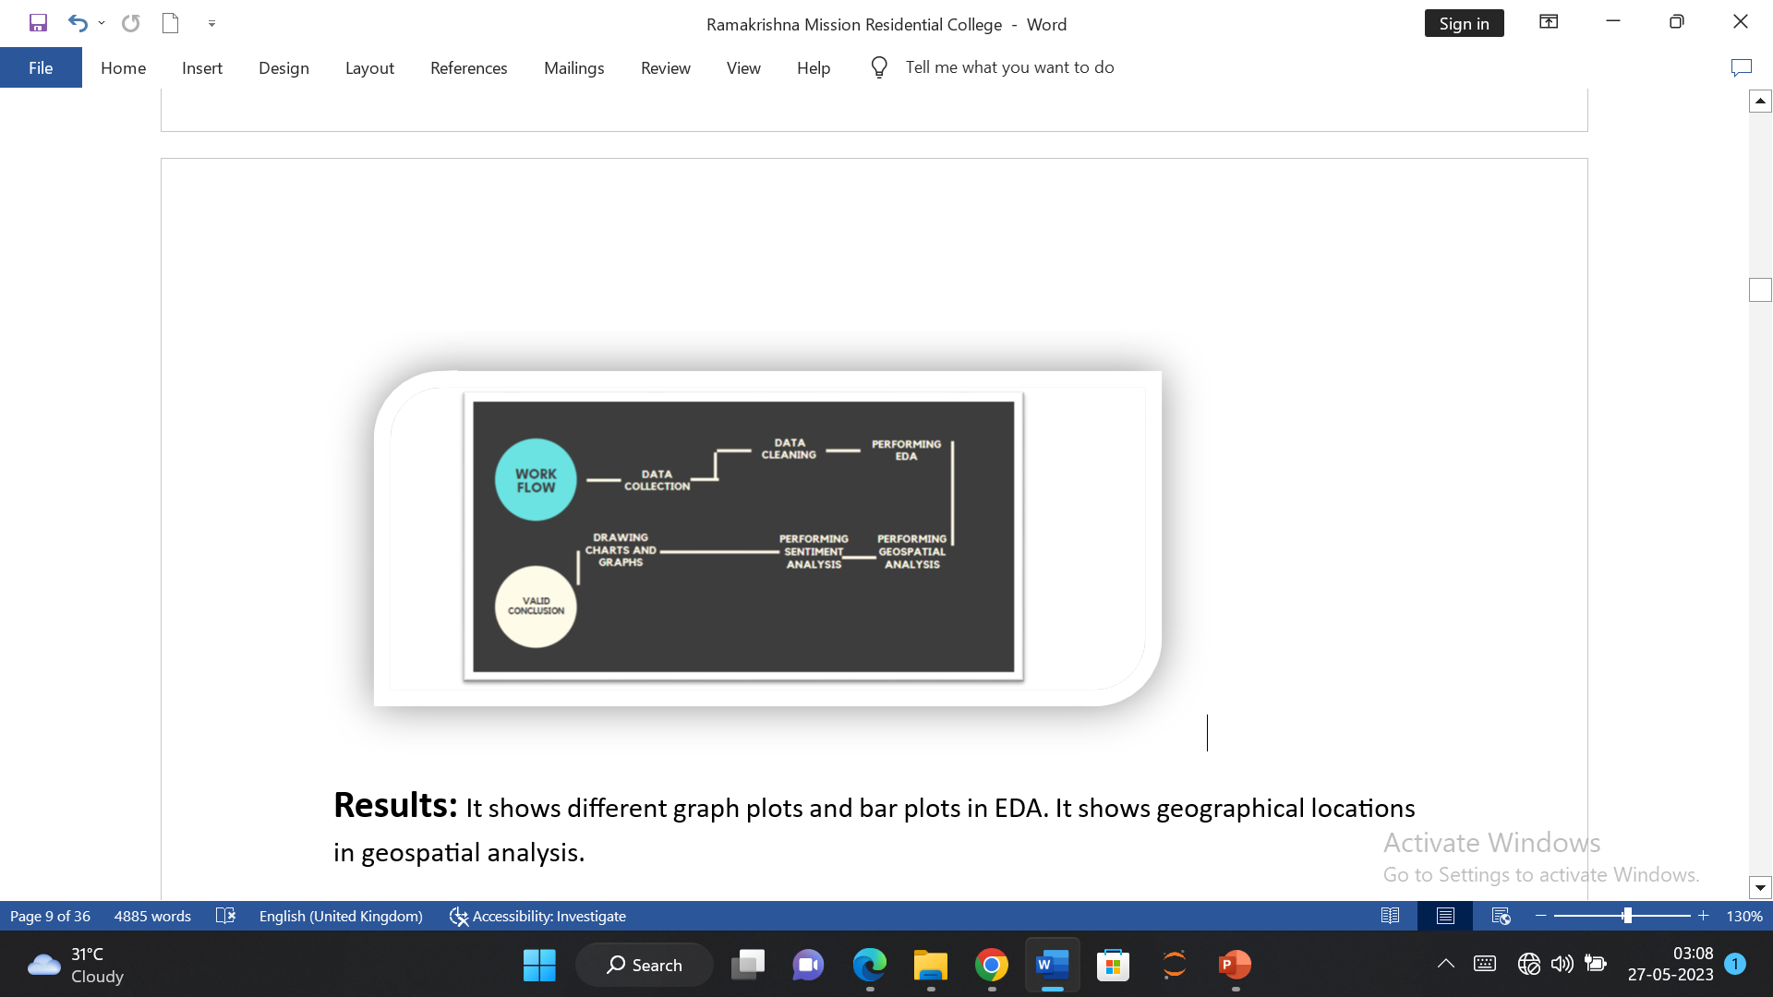
“ZOMATO DATA WITH EDA, GEOSPATIAL AND SENTIMENT ANALYSIS”:[3]
Methodology:

Slide 12
Results:
It shows different graph plots and bar plots in EDA. It shows geographical locations in geospatial analysis.
For Sentiment Analysis “Text Blob” is used to find the positive, negative and neutral comments. Advantage of using Word cloud is it highlight the word based on the frequency of usage and importance, the size of the word will be changed with different types of colors. Which is helpful in finding the customer needs and fulfilling their needs and requirements. In this figure, most of them used the words like Good, Food, Taste, Best, Quality, Great, really etc. Which looks like Positive Comment provided by the customers. Hence these words will be highlighted and coloured based on their usage and frequency of its importance.

Slide 13
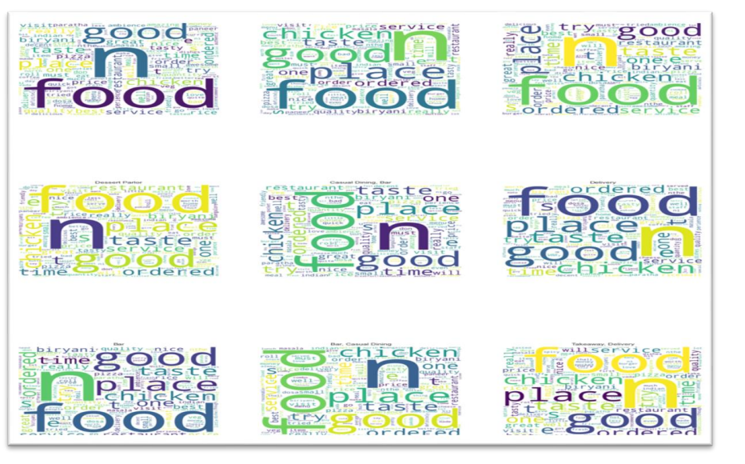

Slide 14
4.METHODOLOGY:
Data Collection:
The dataset is taken from Kaggle, you can find it . Courtesy of Himanshu Poddar, the data is accurate to that available on the Zomato website until 15 March 2019.The URL is https://drive.google.com/file/d/1FSa_x3COvCoMODa44qXufO9CQb3ydqKw/view

Slide 15
4.Data Description:
The dataset contains the following features:
1. URL: This feature contains the URL of the restaurant on the Zomato website
2. address: This feature contains the address of the restaurant in Bangalore
3. name: This feature contains the name of the restaurant
4. online order: whether online ordering is available in the restaurant or not
5. book table: table book option available or not
6. rate: contains the overall rating of the restaurant out of 5
7. votes: contains total number of upvotes for the restaurant
8. phone: contains the phone number of the restaurant
9. location: contains the neighbourhood in which the restaurant is located

Slide 16
10. rest type : restaurant type
11. dish liked : dishes people liked in the restaurant
12. cuisines: food styles, separated by comma
13. approx_cost(for two people) : contains the approximate cost of meal for two people
14. reviews list : list of tuples containing reviews for the restaurant, each tuple consists of two values, rating and review by the customer
15. menu item : contains list of menus available in the restaurant
16. listed_in(type) : type of meal
17. listed_in(city) : contains the neighbourhood in which the restaurant is located.

Slide 17
5.Preprocessing:
The Dataset contained 17 Attributes.
• Records with null values were dropped from ratings columns and were replaced in the other columns with a numerical value.
• Values in the ‘Rating’ column were changed. The ‘/5’ string was deleted. For eg. If the rating of a restaurant was 3.5/5, it was changed to 3.5.
• Using Label Encoding from sklearn library, encoding was done on columns like book_table, online_order, rest_type, listed_in (city).

Slide 18
6.EDA: A lot of effort went into the EDA as it gives us a detailed knowledge of our data. Exploratory Data Analysis (EDA) is an approach/philosophy for data analysis that employs a variety of techniques (mostly graphical) to
• maximize insight into a data set;
• uncover underlying structure;
• extract important variables;
• detect outliers and anomalies;
• test underlying assumptions;
• develop parsimonious models;
• Determine optimal factor settings

Slide 19
7. Machine Learning Tool: The machine learning algorithms used are:
1.Linear Regression:
Linear regression attempts to model the relationship between two variables by fitting a linear equation to observed data. One variable is considered to be an explanatory variable, and the other is considered to be a dependent variable.
For example, a modeler might want to relate the weights of individuals to their heights using a linear regression model.

Slide 20
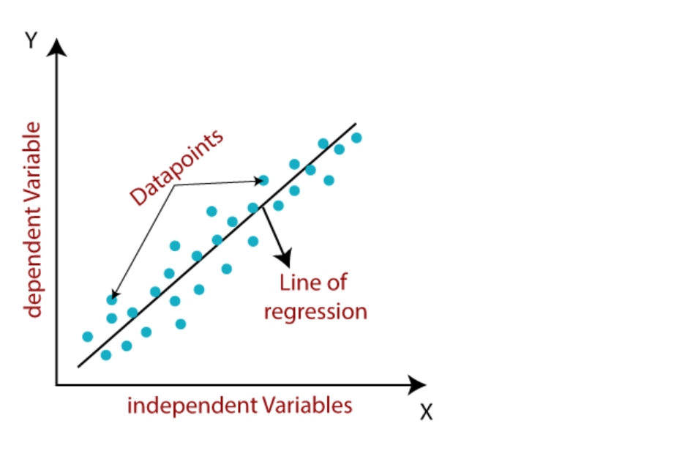

Slide 21
.
Mathematically, we can represent a linear regression as:
Y=a+bX+e
Here,
Y=Dependent variable(Target Variable)
X=Independent variable(predictor variable)
a=intercept of line
b=linear regression coefficient
E=random error

Slide 22
2.Decision Tree
Decision Tree calculation has a place with the supervised learning algorithms. Decision Tree is a supervised learning technique that can be used for both classification and Regression problems, but mostly it is preferred for solving Classification problems.
In a Decision tree, there are two nodes, which are the Decision Node and Leaf Node. Decision nodes are used to make any decision and have multiple branches, whereas Leaf nodes are the output of those decisions and do not contain any further branches.

Slide 23
• The decisions or the test are performed on the basis of features of the given dataset.
• It is a graphical representation for getting all the possible solutions to a problem/decision based on given conditions.
• It is called a decision tree because, similar to a tree, it starts with the root node, which expands on further branches and constructs a tree-like structure.
• In order to build a tree, we use the CART algorithm, which stands for Classification and Regression Tree algorithm.
• A decision tree simply asks a question, and based on the answer (Yes/No), it further split the tree into sub trees. Below diagram explains the general structure of a decision tree.

Slide 24
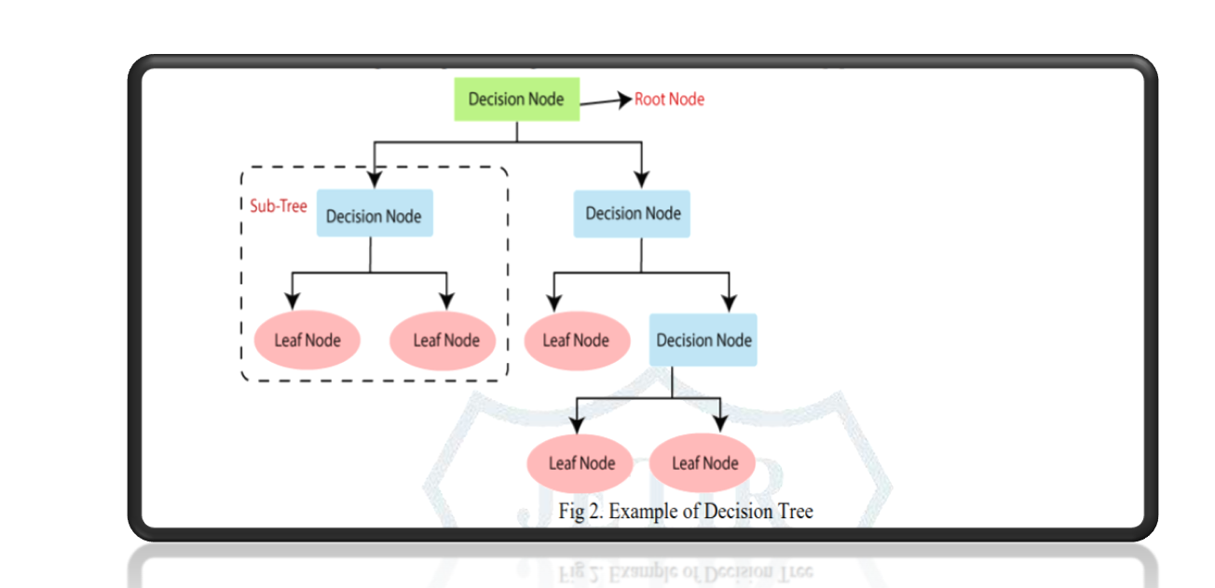

Slide 25
The complete process can be better understood using the below algorithm:
Step-1: Begin the tree with the root node, says S, which contains the complete dataset.
Step-2: Find the best attribute in the dataset using Attribute Selection Measure (ASM).
Step-3: Divide the S into subsets that contains possible values for the best attributes.
Step-4: Generate the decision tree node, which contains the best attribute.
Step-5: Recursively make new decision trees using the subsets of the dataset created in step -3. Continue this process until a stage is reached where you cannot further classify the nodes and called the final node as a leaf node

Slide 26
Attribute Selection Measures
While implementing a Decision tree, the main issue arises that how to select the best attribute for the root node and for sub-nodes. So, to solve such problems there is a technique which is called as Attribute selection measure or ASM. By this measurement, we can easily select the best attribute for the nodes of the tree. There are two popular techniques for ASM, which are:
Information Gain
Gini Index

Slide 27
1. Information Gain:
Information gain is the measurement of changes in entropy after the segmentation of a dataset based on an attribute.
It calculates how much information a feature provides us about a class.
According to the value of information gain, we split the node and build the decision tree.
A decision tree algorithm always tries to maximize the value of information gain, and a node/attribute having the highest information gain is split first. It can be calculated using the below formula:
Information Gain= Entropy(S)- [(Weighted Avg) *Entropy(each feature) ]
Entropy: Entropy is a metric to measure the impurity in a given attribute. It specifies randomness in data. Entropy can be calculated as:

Slide 28
Entropy(s)= -P(yes)log2 P(yes)- P(no) log2 P(no)
Where,
S= Total number of samples
P(yes)= probability of yes
P(no)= probability of no

Slide 29
2. Gini Index:
Gini index is a measure of impurity or purity used while creating a decision tree in the CART(Classification and Regression Tree) algorithm.
An attribute with the low Gini index should be preferred as compared to the high Gini index.
It only creates binary splits
Gini index can be calculated using the below formula:
Gini Index= 1- ∑_{j}P_{j}²

Slide 30
Random Forset:
As the name suggests, “Random Forest is a classifier that contains a number of decision trees on various subsets of the given dataset .
Instead of relying on one decision tree, the random forest takes the prediction from each tree and based on the majority votes of predictions, and it predicts the final output.
The greater number of trees in the forest leads to higher accuracy and prevents the problem of over fitting. The below diagram explains the working of the Random Forest algorithm.

Slide 31
We can understand the working of Random Forest algorithm with the help of following steps –
• Step 1 – First, start with the selection of random samples from a given dataset.
• Step 2 − Next, this algorithm will construct a decision tree for every sample. Then it will get the prediction result from every decision tree.
• Step 3 − In this step, voting will be performed for every predicted result.
• Step 4 − At last, select the most voted prediction result as the final prediction result

Slide 32
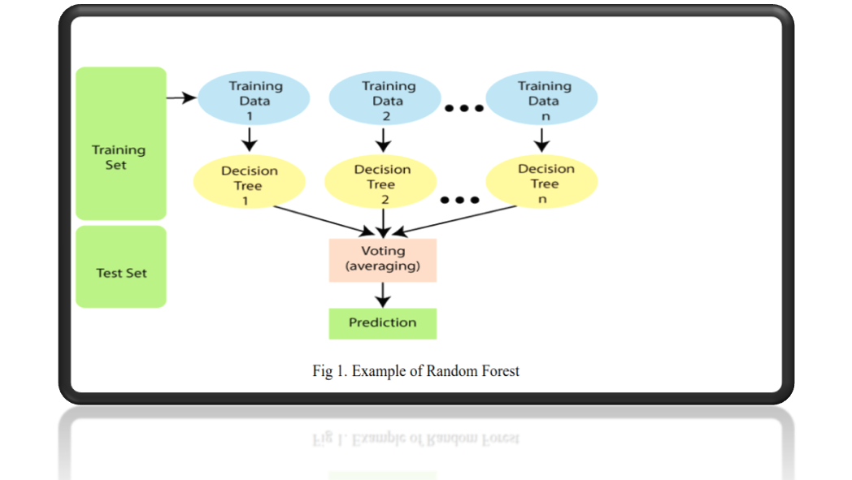

Slide 33
4.Extra Tree:
Extra Trees, short for Extremely Randomized Trees, is an ensemble learning method used for classification and regression tasks. It is an extension the Random Forest algorithm and shares many similarities with it.Extra Trees is a popular choice for solving machine learning problems due to its simplicity and effectiveness.
However, there are some key differences in the way Extra Trees constructs its trees compared to Random Forest.
Random Feature Subsets: In Extra trees, each decision tree is trained on a random subset of features rather than using all the available features. This introduces additional randomness and reduces the corelation between the trees, making the ensemble more drivers.

Slide 34
Random Thresholds: While building the decision trees, Extra tree selects random thresholds for splitting each feature. In Random Forest, the thresholds are determined based on the best possible split, considering impurity measures like Gini index or Information Gain. By selecting thresholds randomly, Extra trees further increases the randomness in the model.
Voting: In the prediction phase, Extra trees combines the predictions of all individual trees by majority voting (for classification) or averaging (for regression) . This ensemble-based approach improves the overall predictions accuracy and robustness of the model.

Slide 35
The benefits of Extra tree include:
1.Reduced Overfitting:
The additional randomness introduced during the tree construction process helps to reduce overfitting, especially when the dataset is small or noisy.
2.Robust to outliers:
Extra Trees is less sensitive to outliers compared to some other algorithms. The random thresholds and feature subsets make the model less likely to be influenced by individual data points.

Slide 36
3.Fast Training:
Extra Trees can be trained relatively quickly compared to a some other ensemble methods since the random feature selection and thresholds eliminate the need for an exhaustive search.
Overall, Extra Trees is a powerful ensemble learning algorithm that combines the strength of decision trees with additional randomness. It is often used when building predictive models and can be effective in a variety of machine learning tasks.

Slide 37
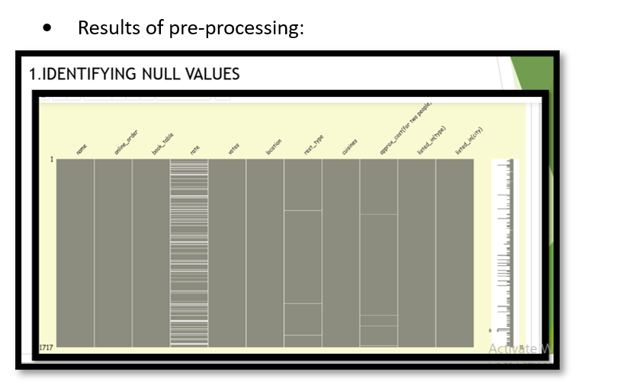
6.Results:

Slide 38
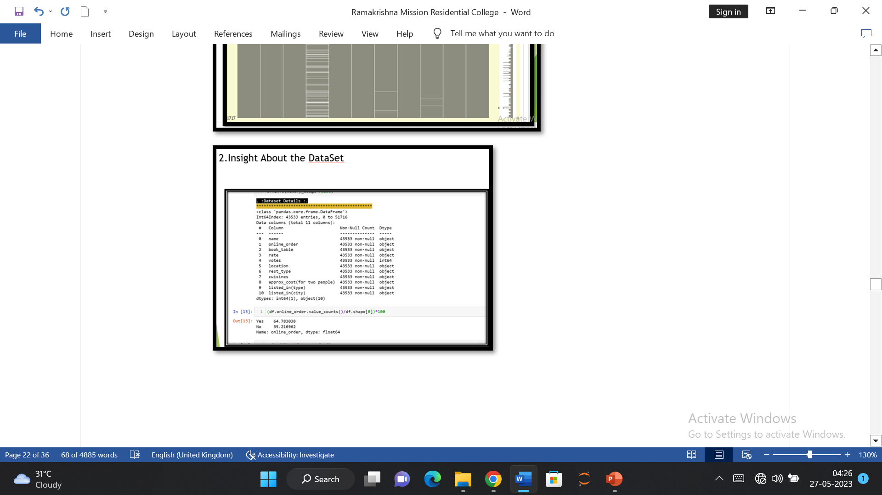

Slide 39
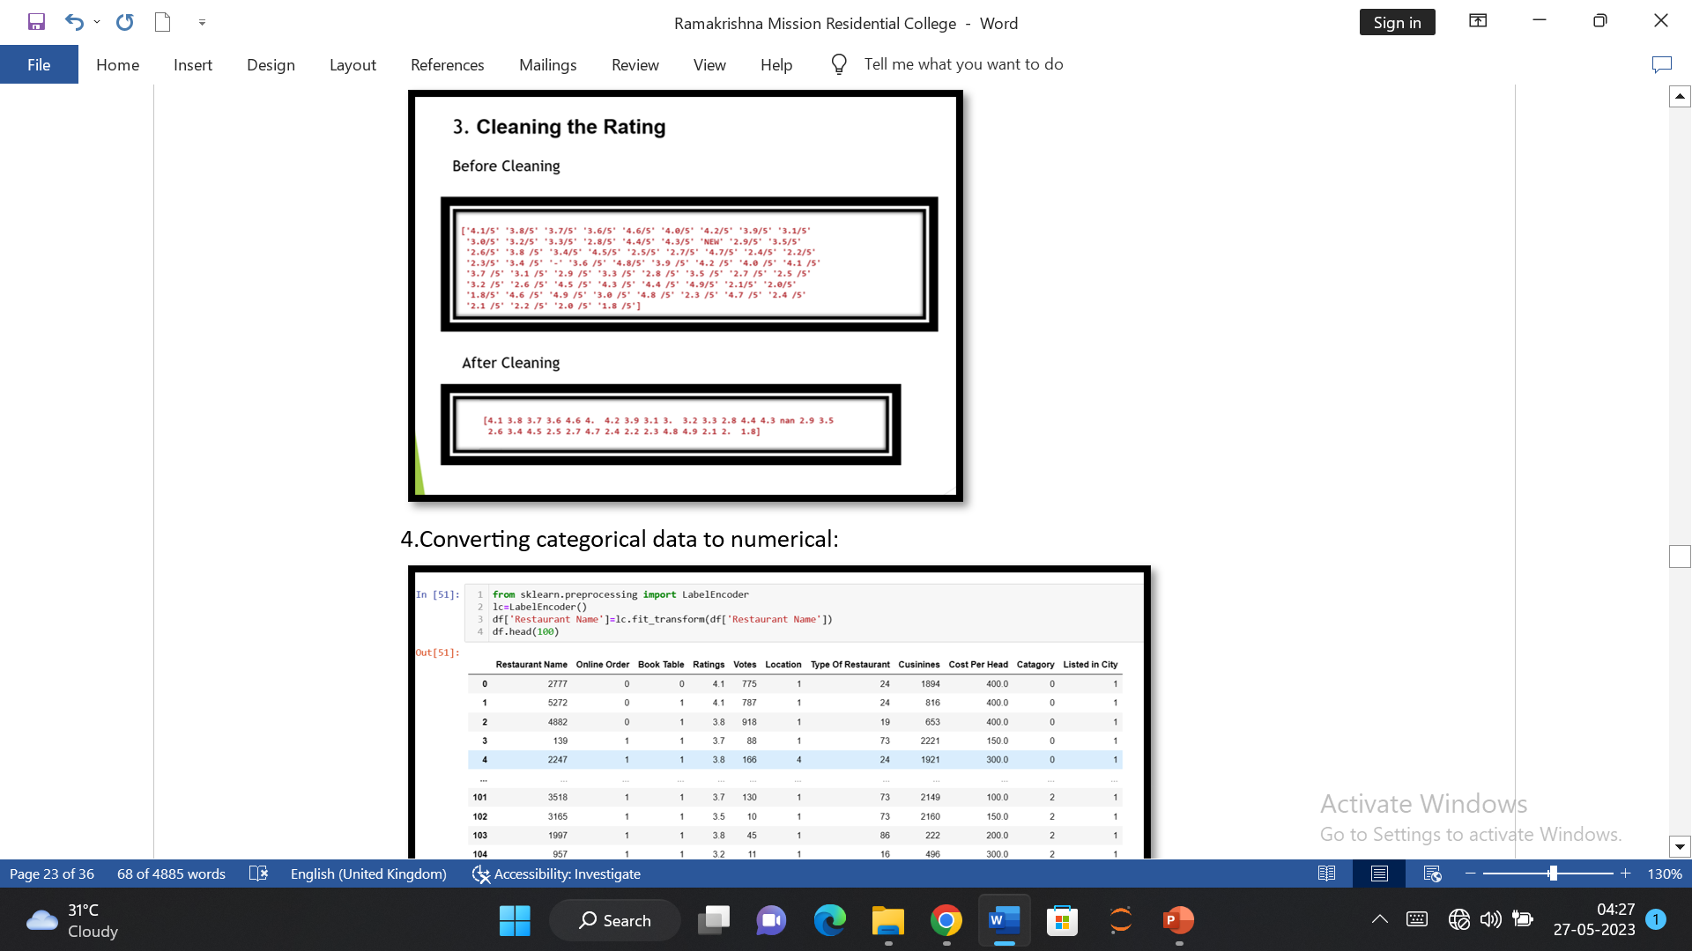

Slide 40
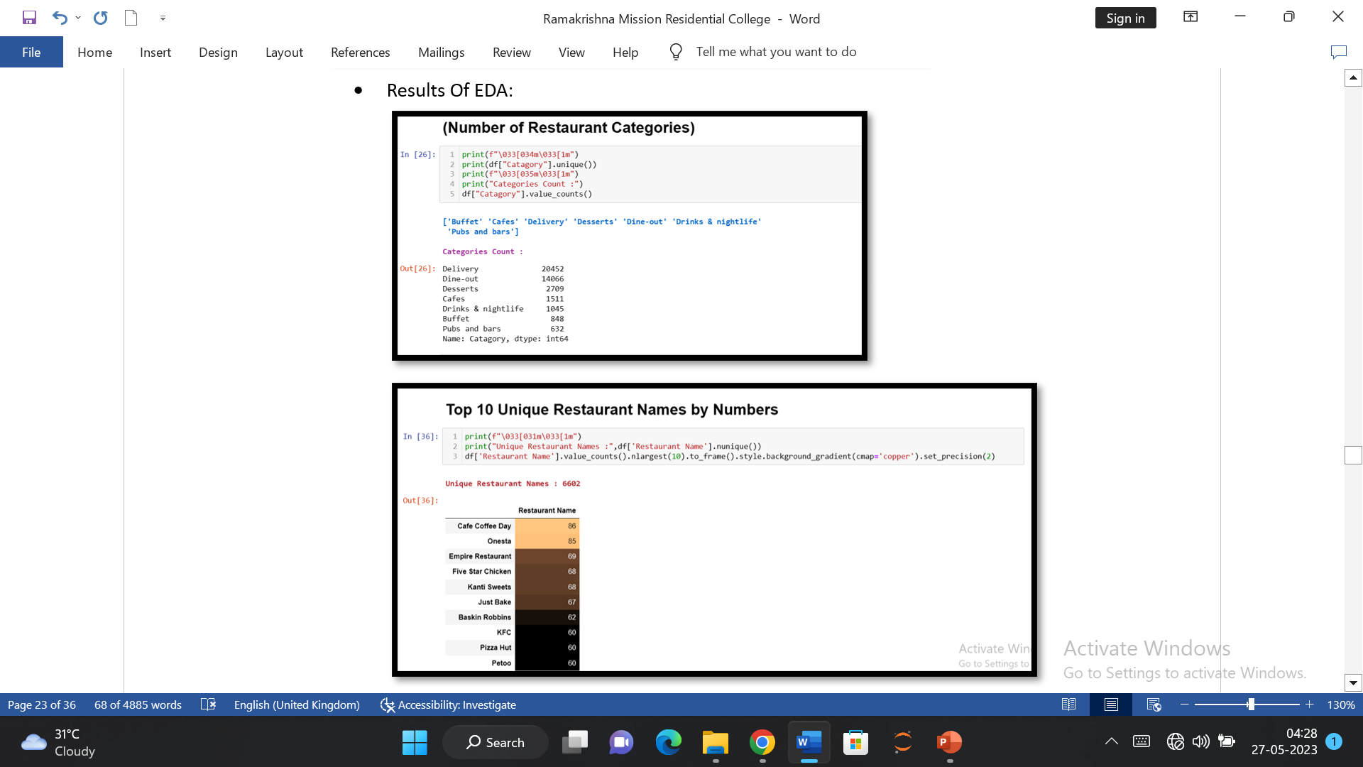

Slide 41
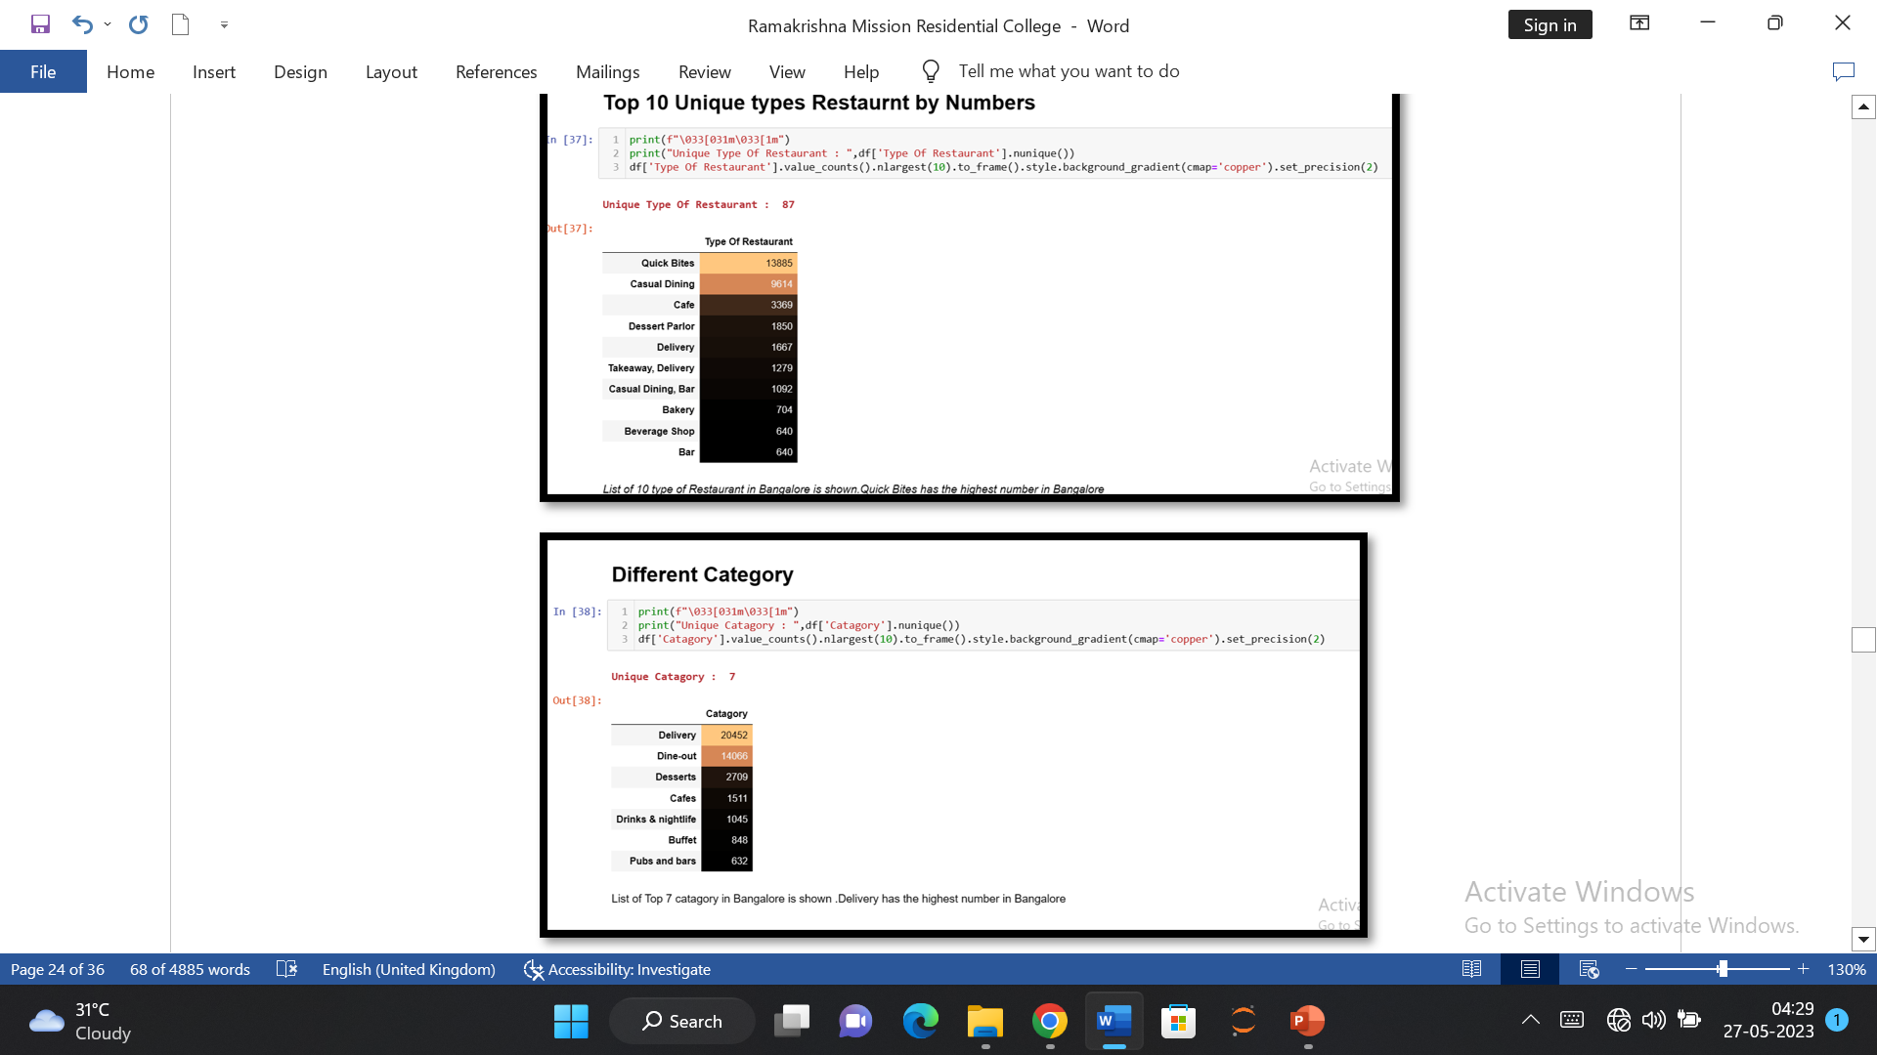

Slide 42
. 3.Results of how other attributes are dependent on Target column (Rate)
Machine learning Algorithm | Accuracy
Linear Regression | 0.26889143495563
Decision Tree | 0.8557481022075478
Random Forest | 0.896842398253808
Extra Tree | 0.9525425731100666
By following this method ,we expect better accurate result than the algorithm available on the internet

Slide 43
7.Observation:
In this project we propose a method i.e. Zomato sales analysis and rating dependency calculation with machine learning model. Here we have used supervised machine learning model which is very simpler in nature.
The main advantage of this learning is that it allows us to produce data output from previous experience.
The biggest challenge of supervised learning is that inaccurate input feature present in training data could give inaccurate results. It has been resolved by doing data pre-processing.

Slide 44
8.Conclusion:
This paper analyses a variety of characteristics of current restaurants in different areas of a city and analyses them to predict restaurant ratings. This makes it an important thing to take into consideration before making a dining decision. Before creating a venture like that of a restaurant, such research is an important part of planning. There has been a lot of research into variables impacting revenue and the competition in the restaurant industry. To enhance customer satisfaction rates, numerous dine-scape variables have been analysed.

Slide 45
9.References:
[1] https://colab.research.google.com.
[2] Chirath Kumarasiri, Cassim Faroo,” User Centric Mobile Based Decision-Making System Using Natural Language Processing (NLP) and Aspect Based Opinion Mining (ABOM) Techniques for Restaurant Selection”. Springer 2018. DOI: 10.1007/978-3-030- 01174-1_4
[3] https://www.kaggle.com/himanshupoddar/zomato-bangalore-restaurants
[4] Atharva Kulkarni, Divya Bhandari, Sachin Bhoite . A study of Restaurants Rating Prediction using Machine Learning Algorithms. International Journal of Computer Applications Technology and Research, 2019, p.377- 378.DOI: 10.7753/IJCATR0809.1008
[5] Linear Regression, Retrieve from: HTTPS://WWW.toworddatascience.com/Linear_ Regression. HTM, LAST Accessed: 5 October, 2019

Slide 46
[6] L. Breiman, Random Forests. Machine Learning, 45(1), (2001); 5–32. https://doi.org/10.1023/A:1010933404324 [7]https://www.tutorialspoint.com/machine_learning_with_python/machine_learning_with_python_classification _algorithms_random_forest.htm
[8] https://www.techleer.com/articles/107-random-forest-supervised-classification-machine-learning-algorithm
[9] Decision Trees, retrieve from: https://dataaspirant.com/2017/01/30/how-decision-treealgorithm-works/, Last Accessed: 5 Octobor,2019 [10] https://www.kdnuggets.com/2020/01/decision-tree-algorithm-explained.htm

Slide 47
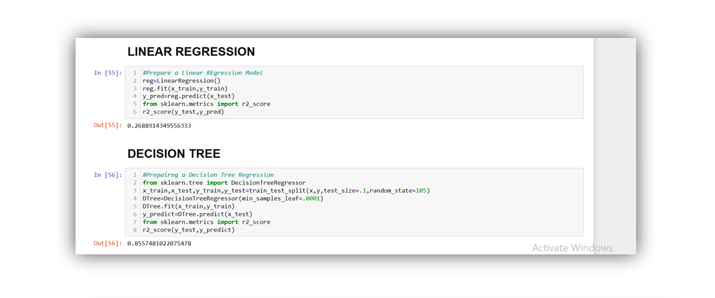
10.Appendix:

Slide 48
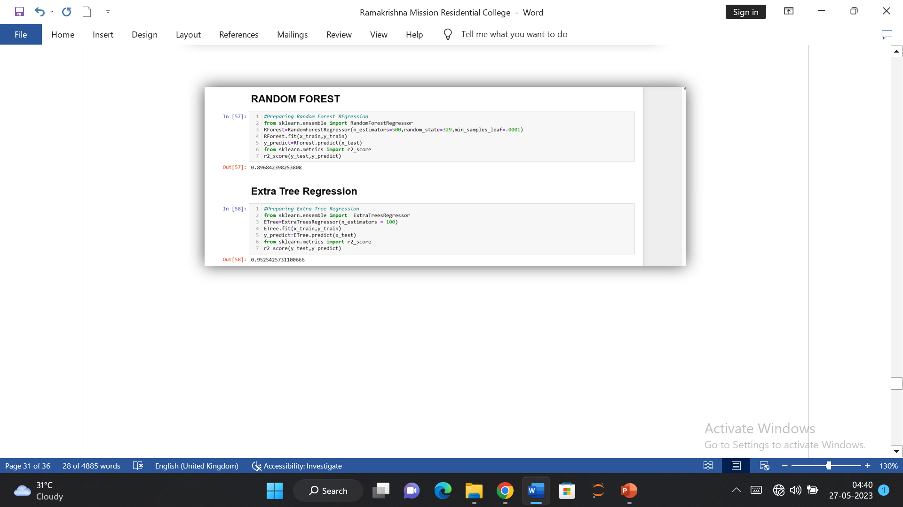

Slide 49
ACKNOWLEDGEMENT: I,Soumyadip China, would like to express my sincere thanks and gratitude to Sri Debasis Sardar for letting me work on this project .I am very grateful to him for his continuous support and guidance in Completing this project. I am thankful to all the professors of the Department of Computer Science, RKMRC as well .I was able to successfully complete this project with the help of their guidance and support. Finally ,I want to thank all my friends as well.

Slide 50
THANK YOU

